Slide 1
“Factors” of Income:
A Machine Learning Analysis of US Census Salary Data.
By Jordan Evans-Kaplan
Econ 490: Machine Learning

Slide 2
Motivation
Studying Census data allows economists to grasp the driving forces behind Income.
My goal was to regress two factor income levels: “<=$50K” and “>$50K” and identify the most critical variables to predict annual income thresholds. Some of the most effective variables included were:
Marital Status
Age
Capital Gains
The future applications of this work include generalizing economic health in regions without income data, but where the predictor variables are available.
This allows data scientists to analyze the economic health of entire populations, rather than just one component.
Potential downside:
High computing/processing cost due to large datasets.

Slide 3
Literature Review
Kohavi, "Scaling Up the Accuracy of Naive-Bayes Classifiers: A Decision-Tree Hybrid.", Proceedings of the Second International Conference on Knowledge Discovery and Data Mining.
Landmark paper which began the study into Census Income classification.
Chakrabarty, “A Statistical Approach to Adult Census Income Level Prediction.”
Recent paper which set the current record with this dataset at 88.16%.

Slide 4
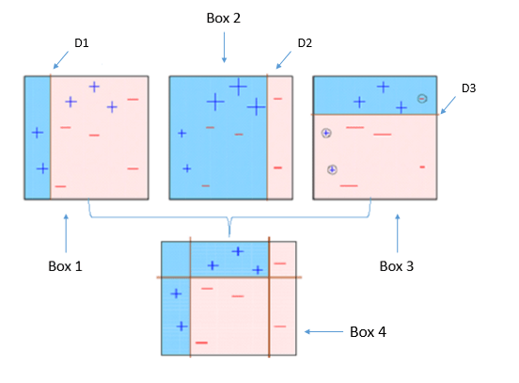
What is XGBoost?
Stands for:
eXtreme Gradient Boosting.
XGBoost is a powerful iterative learning algorithm based on gradient boosting.
Robust and highly versatile, with custom objective loss function compatibility.

Slide 5
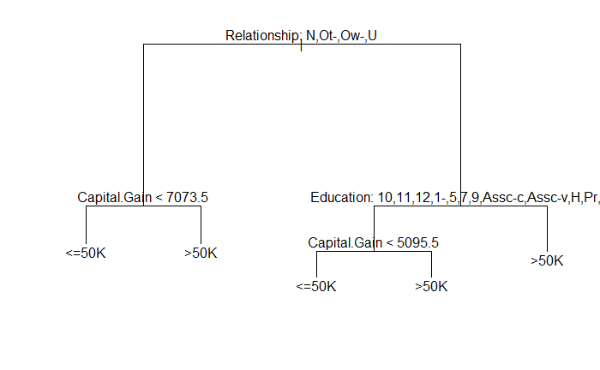
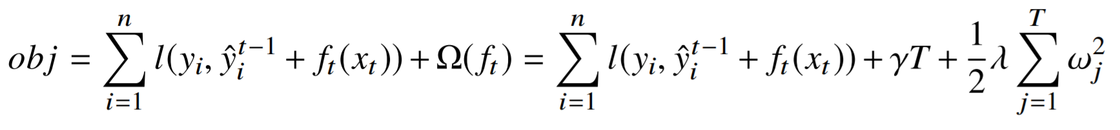
How does XGBoost work?
Tree-Based Boosting algorithm.
4 Critical Parameters for Tuning:
η: ETA or “Learning Rate”
max_depth: Controls the “height” of the tree via splits.
γ: Minimum required loss for the model to justify a split.
λ: L2 (Ridge) regularization on variable weights.

Slide 6
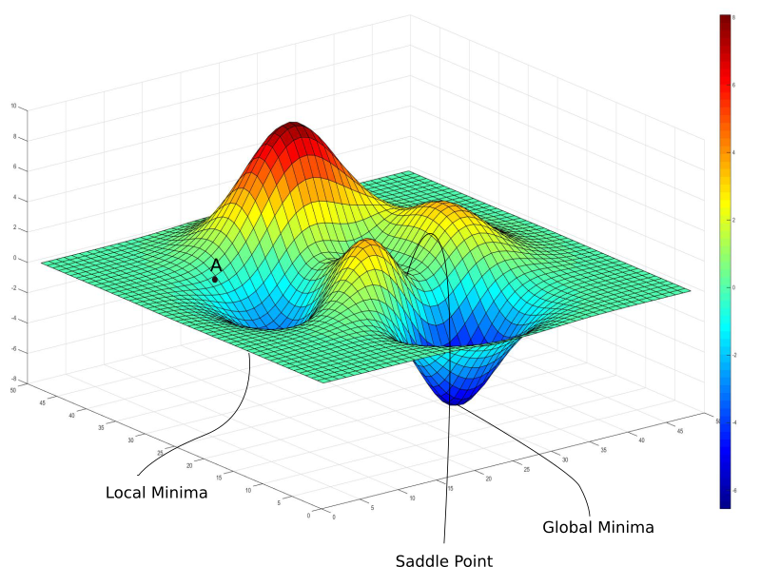
Why use Xgboost?
All of the advantages of gradient boosting, plus more.
Frequent Kaggle data competition champion.
Utilizes CPU Parallel Processing by default.
Two main reasons for use:
Low Runtime
High Model Performance

Slide 7
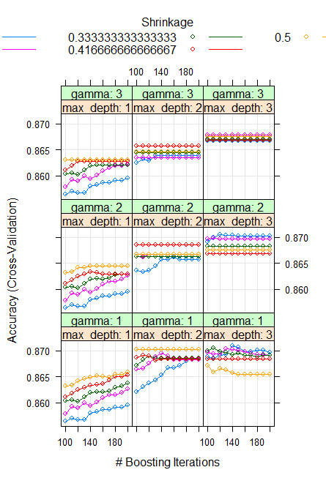
Tuning XGBoost
In order to produce the optimal XGBoost model, a grid-search method was employed against a hyper-grid of possible parameters.
After tuning the model against these possibilities, the following graph was produced:
Figure shows the accuracy in each of the 9 possible grids.
Highest accuracy was obtained in the bottom right quadrant, where the value of Gamma is 1, and Max Tree Depth is 3.
The blue line represents the shrinkage rate of 1/3, otherwise called ETA.

Slide 8
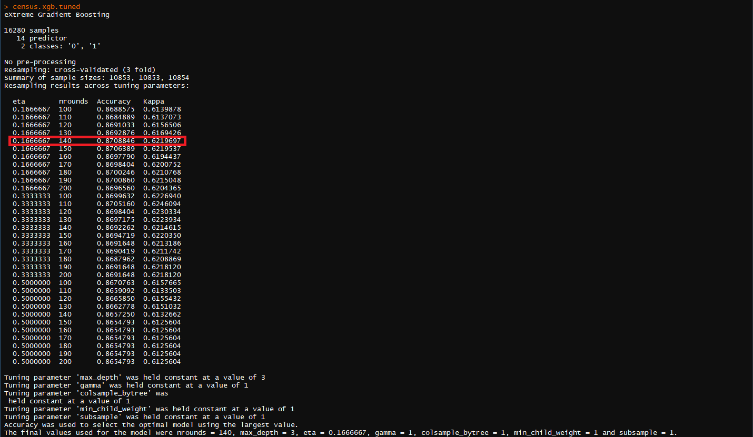
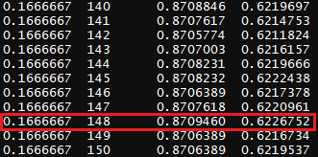

Model Results:

Slide 9
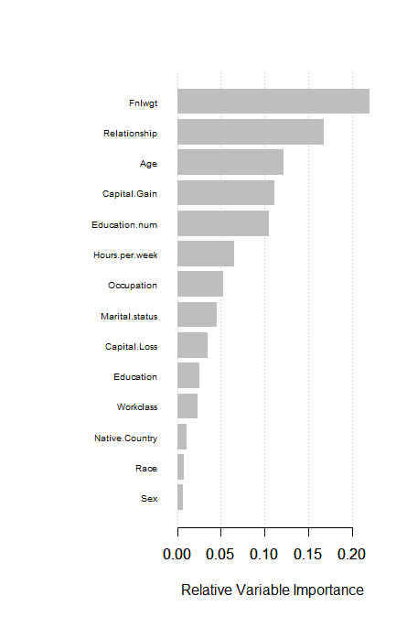
Conclusion:
XGBoost Accuracy before tuning: 84.66%
Tuned XGBoost Accuracy: 87.09460%
Models such as these allow for robust income classification, and identify key variables associated with higher income brackets.
Accuracy : 0.8466
Accuracy: 0.870946

Slide 10
Thank You!
Special appreciation goes out to:
Econ 490 Machine Learning Staff:
Nazanin Khazra
Abdollah Farhoodi
Designer of XGBoost:
Tianqi Chen
Personal Contact Information:
Jordan Evans-Kaplan
Email: Evanska2@Illinois.edu

